Slide 1
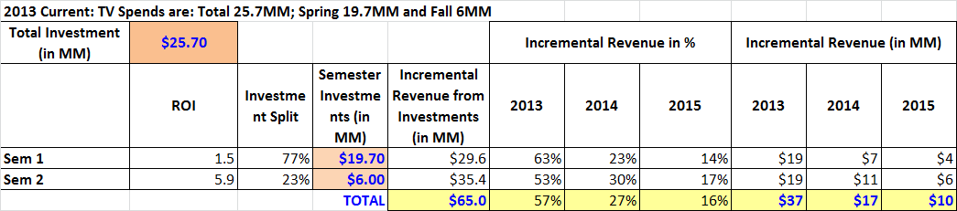
Projected Incremental Revenue from 2013 TV campaign
Assumption: 2013 Spring and Fall ROIs are similar to Aug-2009 to July-2011 measurement period.
2013 Current: TV Spend of $25.7MM [Spring $19.7MM and Fall $6MM] may generate $65MM ($37MM in 2013)
Previous Nasonex TV analysis had study period between Aug-2009 to Jul-2011.

